Slide 1

RAGHU ENGINEERING COLLEGE (AUTONOMOUS) DEPARTMENT OF ELECTRICAL AND ELECTRONICS ENGINEERING
ENERGY AUDITING THROUGH
MACHINE LEARNING
PREPARED BY :
Mr. G. NAVA BHARGAV (16981A0224)
Mr. B. MOHAN SAI (17985A0214)
Mr. K. HEMANTH KUMAR (17985A0229)
UNDER THE GUIDANCE OF :
Mr. I Ravi kiran (Associate Professor)
(Electrical and Electronics Engineering Department)

Slide 2
OVERVIEW:
OBJECTIVE
ABSTRACT
EXISTING ENERGY AUDITING METHODS
IMPORTANCE OF ENERGY CONSERVATION
ROLE OF MACHINE LEARNING
PROPOSED PROJECT , FLOWCHART
LOAD CLASSIFICATION
ASSESSMENT
RESCHEDULING
AUDIT REPORT

Slide 3
OBJECTIVE:
To develop a system which can classify the loads connected, audit energy by clustering the data and gives an overall report. Thus, can efficiently take decisions with the trained data.

Slide 4
ABSTRACT:
An energy audit is a survey and an analysis of energy flows for energy in a building or a network. It includes a process or system to reduce the amount of energy input into the system without negatively affecting the output.
An energy audit requires a detailed survey and an analytical understanding of a business operating pattern’s. Energy audits can be characterised into 5 broad types. They are:- Bench marking, Walk-through audit, Detailed audit, Investment-grade audit, Energy diagnosis.

Slide 5
EXISTING ENERGY AUDITING METHODS:
Bench Marking : - In this method, we consider two identical buildings and based on the historic utility use and cost and the comparisons of the performances of the buildings to those of similar buildings.
Walk-Through Audit: - In this method, an analysis of utility billing information, operating data, and building equipment plays a vital role.
Detailed Audit: - This Energy audit method deals with the analysis of energy conservation measures and energy saving opportunities.
Investment-grade audit: - This type of energy audit involved detailed analysis of capital-intensive improvements and require rigorous engineering analysis.
Energy Diagnosis: - This audit includes performing some economic calculations and may include using some metering devices

Slide 6
IMPORTANCE OF ENERGY CONSERVATION:
“The earth provides enough to satisfy every man’s needs but not every man’s greed”, said Gandhiji. Hard facts on why energy conservation is a must are outlined below:
We use energy faster than it can be produced - Coal, oil and natural gas - the most utilised sources take thousands of years for formation.
Energy resources are limited - India has approximately 1% of world’s energy resources but it has 16% of world population.
Most of the energy sources we use cannot be reused and renewed - Non renewable energy sources constitute 80% of the fuel use. It is said that our energy resources may last only for another 40 years or so.

Slide 7
We save the country a lot of money when we save energy - About 75 per cent of our crude oil needs are met from imports which would cost about Rs.1, 50,000 crore a year
We save our money when we save energy - Imagine your savings if your LPG cylinder comes for an extra week or there is a cut in your electricity bills
We save our energy when we save energy - When we use fuel wood efficiently, our fuel wood requirements are lower and so is our drudgery for its collection
Energy saved is energy generated - When we save one unit of energy, it is equivalent to 2 units of energy produced
Save energy to reduce pollution - Energy production and use account to large proportion of air pollution and more than 83 percent of greenhouse gas emissions
An old Indian saying describes it this way – “The earth, water and the air are not a gift to us from our parents but a loan from our children”. Hence we need to make energy conservation a habit.

Slide 8
ROLE OF MACHINE LEARNING:
Because of new computing technologies, machine learning today is not like machine learning of the past. It was born from pattern recognition and the theory that computers can learn without being programmed to perform specific tasks; researchers interested in artificial intelligence wanted to see if computers could learn from data. It’s a science that’s not new – but one that has gained fresh momentum.
This machine learning is broadly classified into 4 types: Supervised learning, Unsupervised learning, Semi-supervised learning, Reinforcement learning.

Slide 9
PROPOSED PROJECT:
Most of the Energy Auditing methods are Theoretically proved and yet need to be proved practically. Hence, A real-time auditing is required that consider weather and other priority factors. In this work, a novel method of energy auditing is proposed that uses machine learning techniques to classify running loads and identify energy wastage.
There is an enormous need for Energy Auditing, the following are the reasons which explains the need of Energy conservation:
To reduce the Energy Consumption and hence the Electricity Bill.
To reduce the transmission and Distribution Losses and to increase the system efficiency.
To extend the life of the System utilities for effective life cycle.

Slide 10
It reduces the cost of production in Industrial output.
To reduce the use of Fossil fuels, thus creates an impact and awareness on the proper utilization of renewable sources.
To reduce the additional demand on Generating stations, Transformers and other equipment’s.
To reduce the carbon Emission thus protecting Environment and to save the Earth from Environmental Effects.

Slide 11
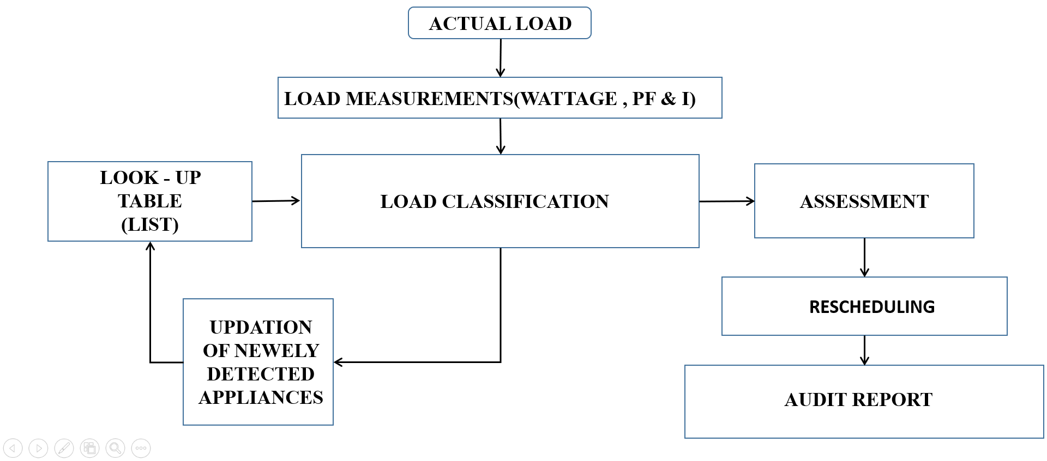
FLOWCHART:

Slide 12
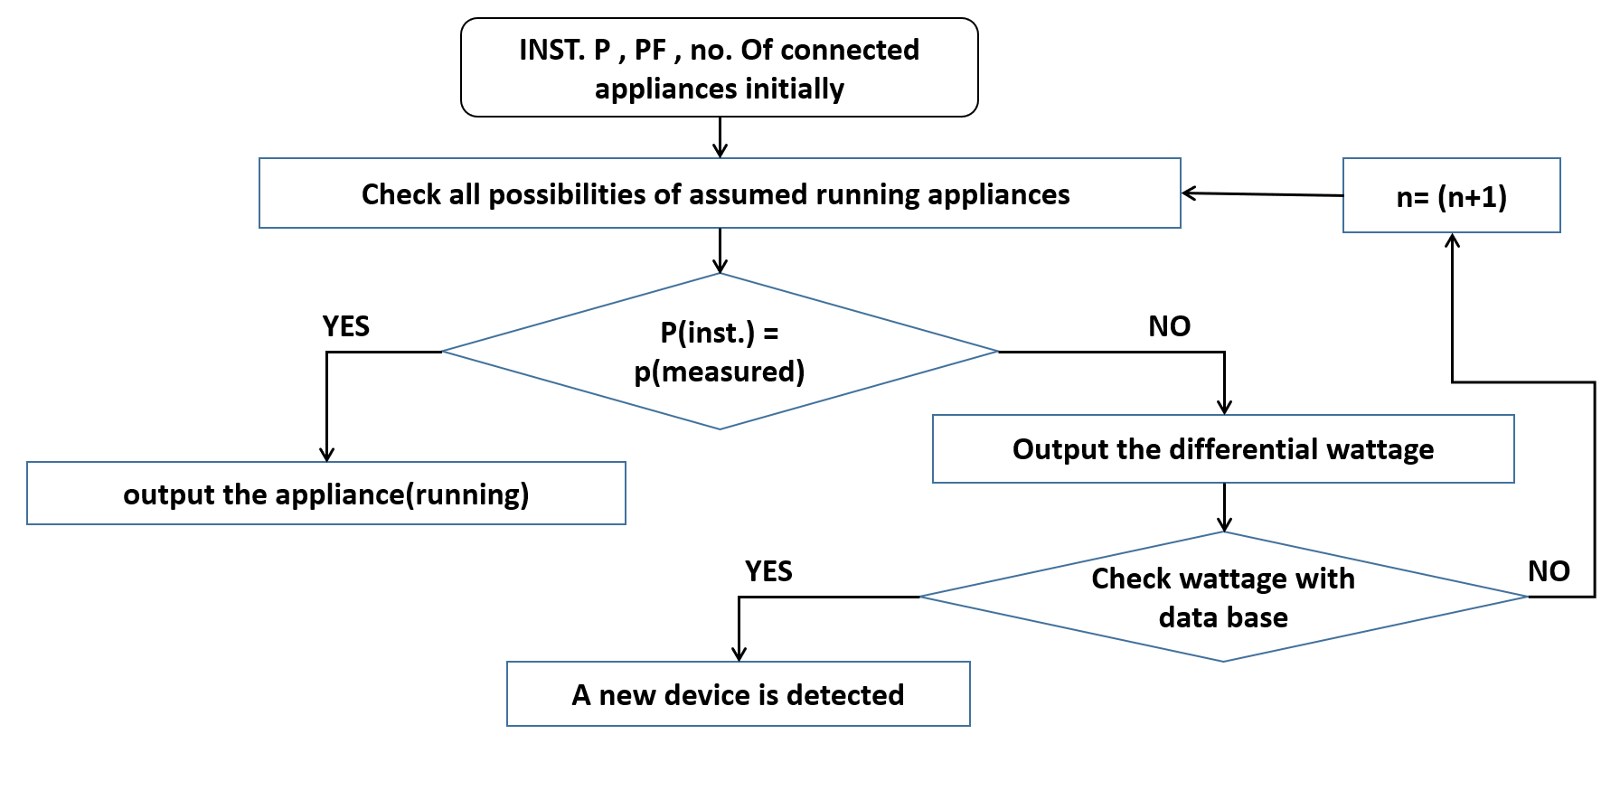
LOAD CLASSIFICATION:

Slide 13

This code generates the ‘n’ required combinations which were required to identify the correct combination or the correct set of utilities which are turned “ON”.
The value of ‘n’ depends on data stored in the data base. Thus, the value ‘n’ is autogenerated.

Slide 14
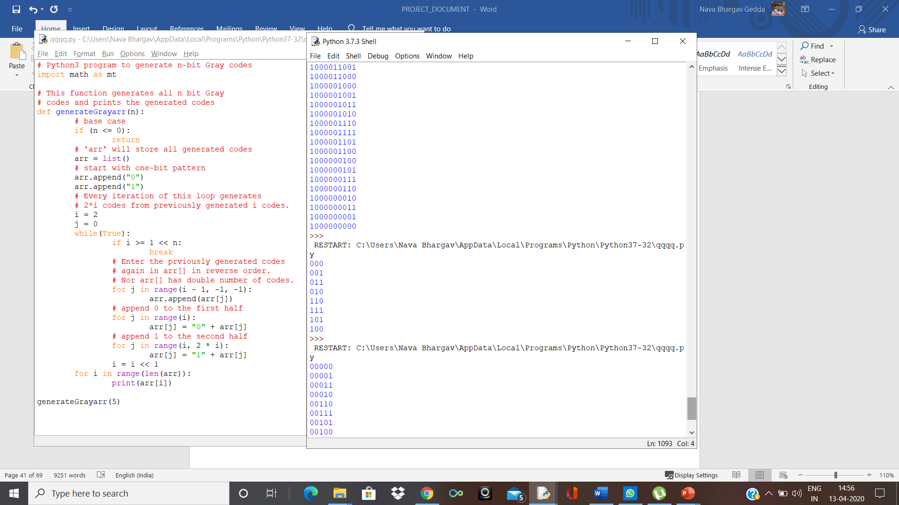
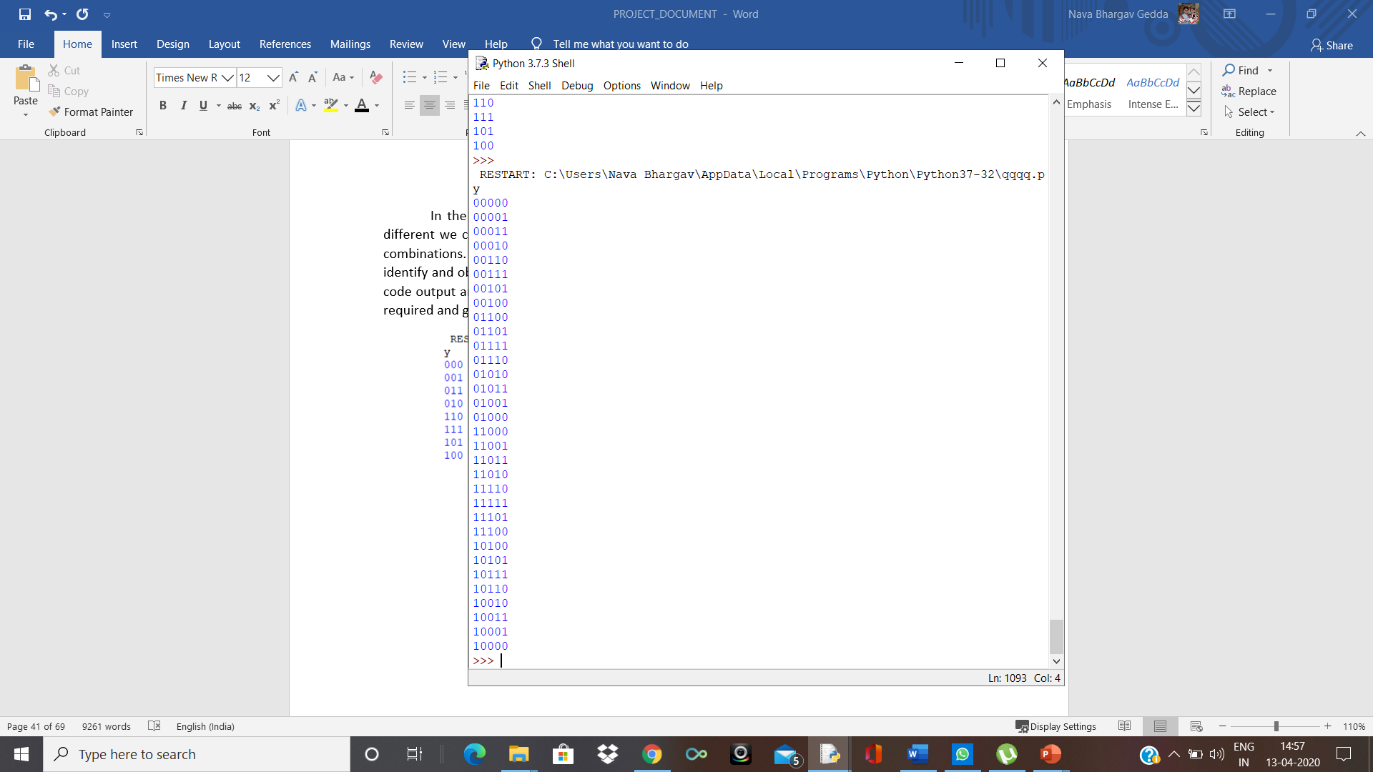
N=3
N=5

Slide 15
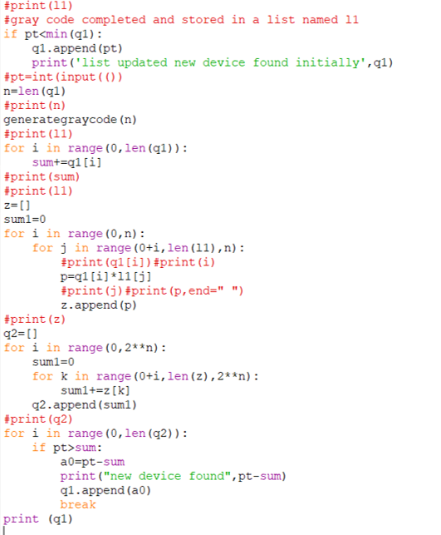
Python program which defines all the Three different cases of Load classification:

Slide 16
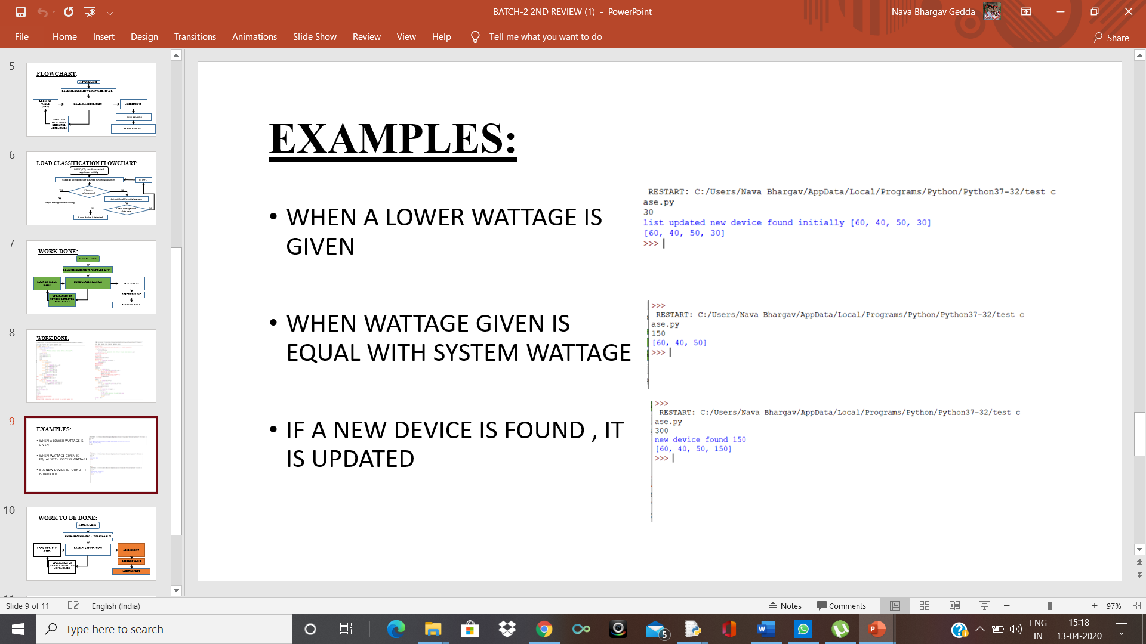
Three different cases of load classification:
CASE 1:
In this case 1, initially a new utility is detected so the data base gets updated initially with a message shown as stated above which states, “list updated new device found initially”. Thus, our data base updates and thus the classification of load takes place.

Slide 17
CASE 2:
In this case 2, the no new device is found initially and the result with no other comment states that all the devices are in ON state so to represent that the actual wattage of the devices are printed out as shown above.

Slide 18
CASE 3:
In this case 3, there is a new utility found as shown above so even after executing the gray code the system detects it and to represent that it is printed as ‘new device found’, with its wattage printed as shown above. Now since the new device is found the system now increments the value of n and the load classification process takes place.

Slide 19
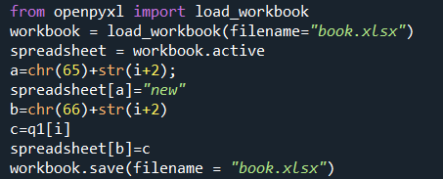
ASSESSMENT:
The process of gathering and discussing information from multiple and diverse sources in order to develop a deep understanding and to perform a specified task.
Program to create a data base(An Excel sheet) and to update it accordingly.

Slide 20
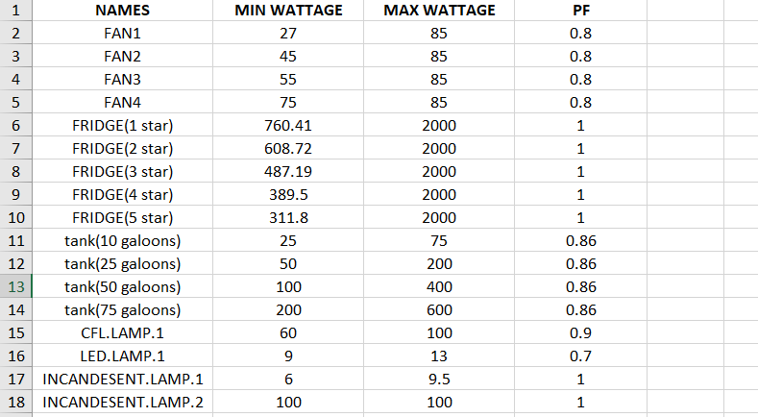
Database with the utility data stored in an excel sheet:

Slide 21
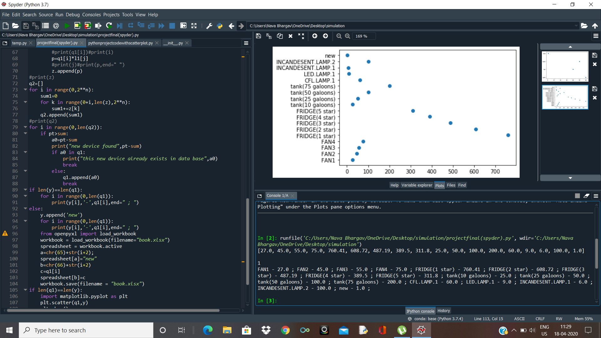
RESCHEDULING:
Arranging a plot with the previous data for easy understanding, processing and identification purpose.

Slide 22
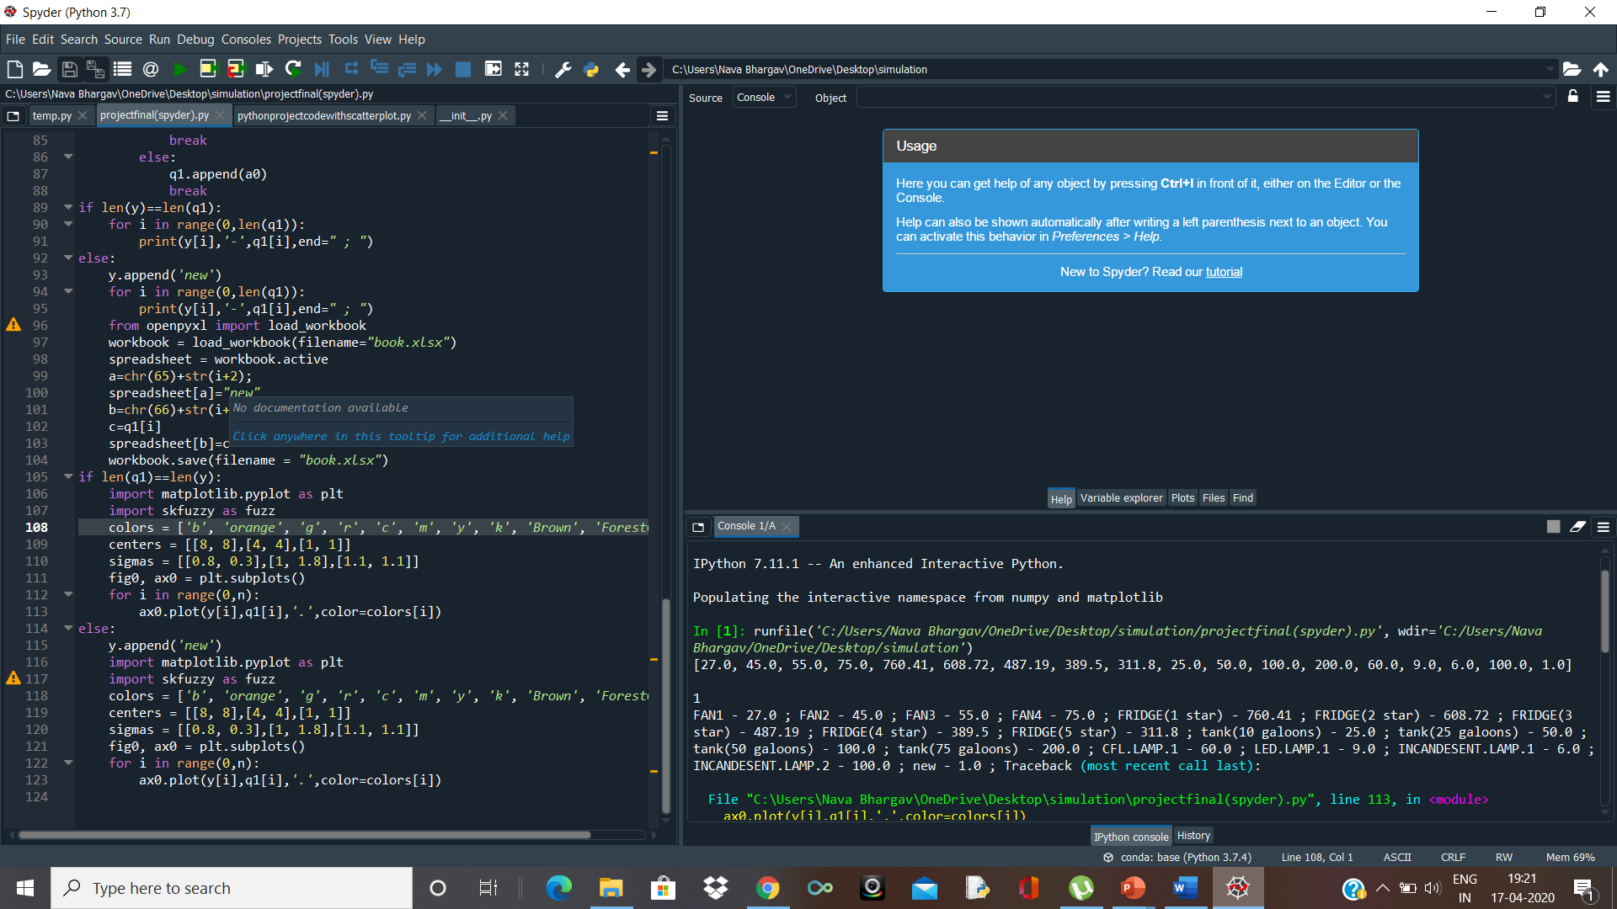
AUDIT REPORT:
An audit report is an overall report outputted for the consumers to output the desired quantity which might include values, plots, graphs or any important data which is useful for the purpose of auditing.
We can represent the entire system by plotting in a single flowchart as shown below. The below flowchart has both mathplotlib and skfuzzy. Skfuzzy is used for the purpose of clustering of data so that for any new data without following the previous steps the system can accurately decide with the help of clustering.

Slide 23
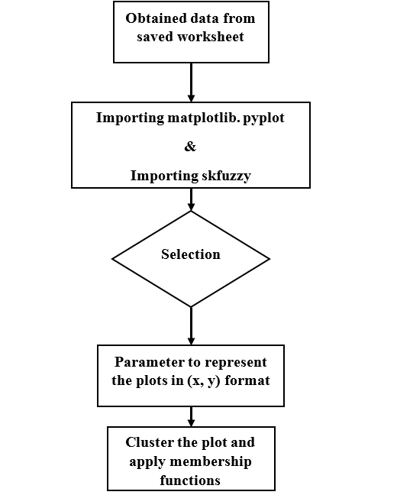
FLOWCHART:

Slide 24
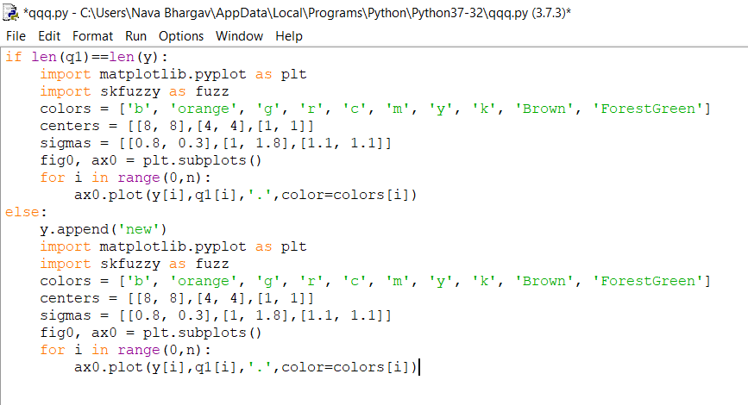
Program representing the implementation of both mathplotlib and skfuzzy:

Slide 25
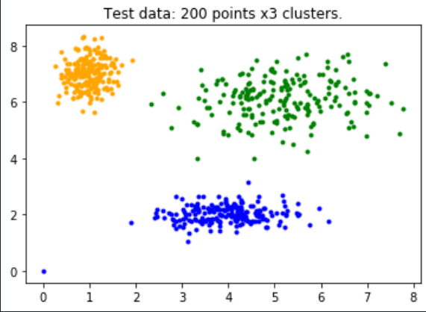
Clustered output of 3 utilities over a period of time:

Slide 26
THANK YOU

